Slide 1
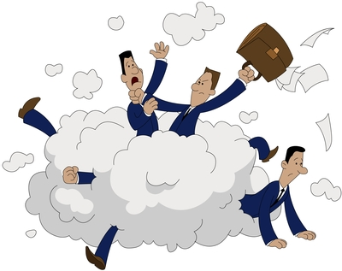
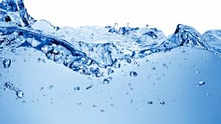
WANGRY : ARE WE ANGRY FOR WATER

Slide 2
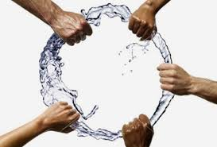
Agenda
Team & Project Structure
Project Scope & Definitions
Problem Statement & Research Questions
Methods
Findings
Implications of Our Research Method
Conclusions
Resources

Slide 3




Project Team
Naim Panjwani Swati Madan
Mariaveronica Sayewich
Jose Tomines

Slide 4

Project Scope
Our group explored how climate change impacts the global freshwater supply, and if low freshwater areas experience more conflict. We then assessed the United States water status to see if there are any trends.

Slide 5
Definition Check
Freshwater is any naturally occurring water except seawater and brackish water. Fresh water includes water in ice sheets, ice caps, glaciers, icebergs, bogs, ponds, lakes, rivers, streams, and even underground water called groundwater.
Water conflict is a term describing a conflict between countries, states, or groups over an access to water resources.
Drinking water, also known as potable water, is water that is safe to drink or to use for food preparation.

Slide 6
Problem Statement & Research Questions
How does (fresh)water access correlate with conflict?
How does climate change impact freshwater access?
Do areas with low freshwater access have higher instances of conflict?
What areas in the United States have less access to water?
Do these areas with low water access have higher instances of conflict?

Slide 7
Breakdown of Tasks
Each WANGRY team member was assigned an individual breakdown question
The breakdown questions were separated to the global and US situations
Team members worked closely with their partner to ensure that input to downstream activity would be met
The full team then worked together in the Team Checkpoint, Code, and Presentation assembly.

Slide 8


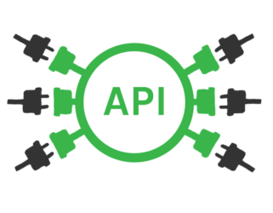



Methods
Population API
World Bank Climate Change API
UCDP API
FBI API
CDC DATA
Pandas Data Frame manipulations using merge
Plotting in Python using matplotlib
USGS Water Services
US Census Data

Slide 9


Findings

Slide 10
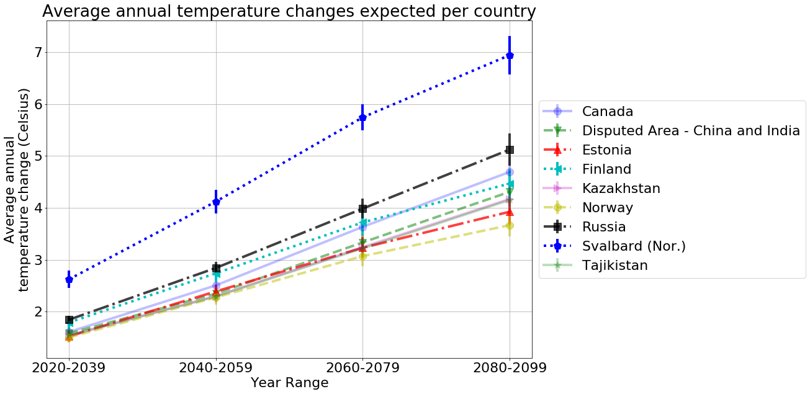
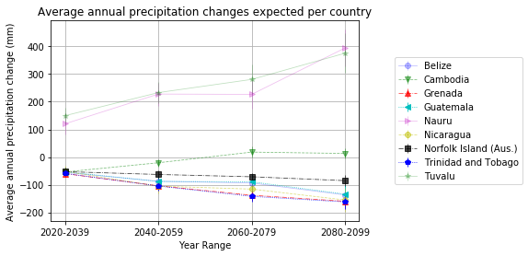
How does climate change impact freshwater access?
Notes:
Naim
Discusses northern country temperature changes
We are focusing on the countries that have decreasing precipitation changes

Slide 11
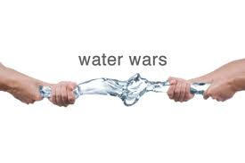
Do these countries with low water have higher instances of conflict?
Notes:
Jose to add notes

Slide 12
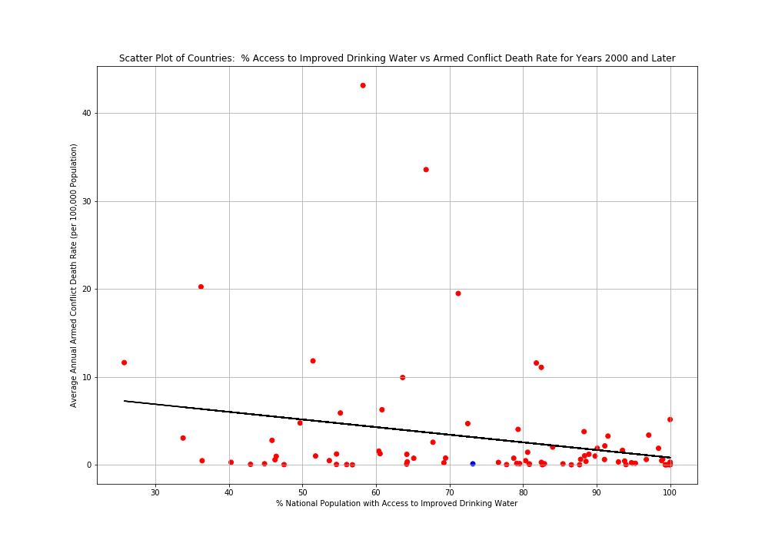
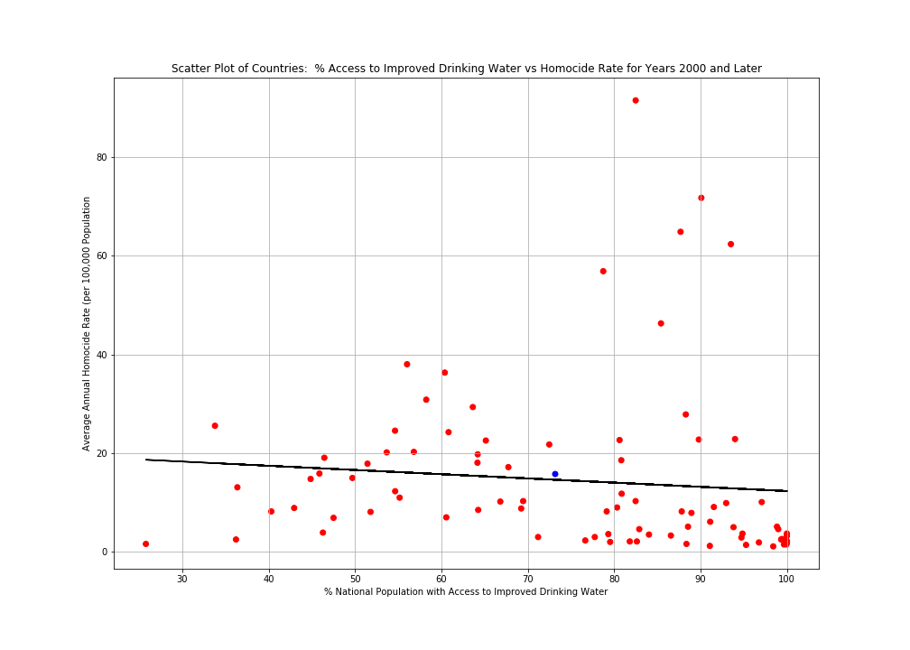
Do these countries with low water have higher instances of conflict?
Notes:
Jose
There is a slight trend that less access has a higher rate of death

Slide 13
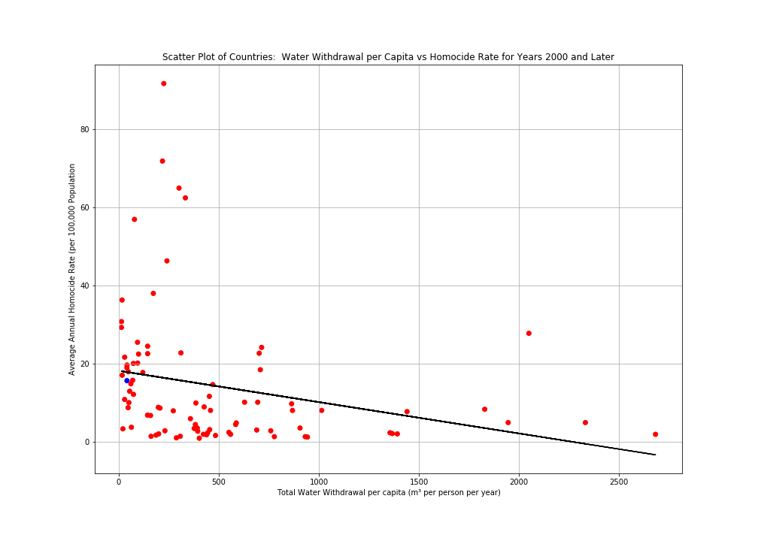
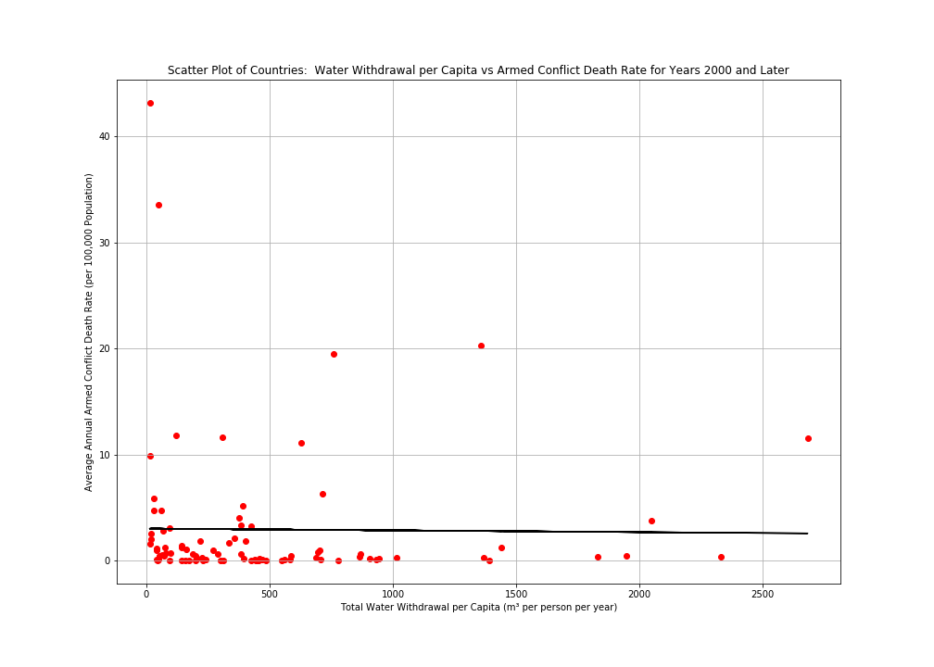
Notes:
Jose
The higher the water withdrawal the less deadly the armed conflicts

Slide 14
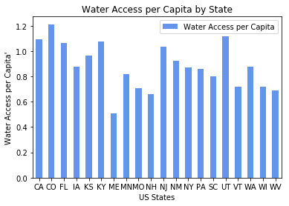
What areas in the United States have less access to water?
*Population and water data are from different sources
Notes:
Swati to add notes
US states have adequate water available in almost all stores. Maine state seems to have less water access compared to population

Slide 15
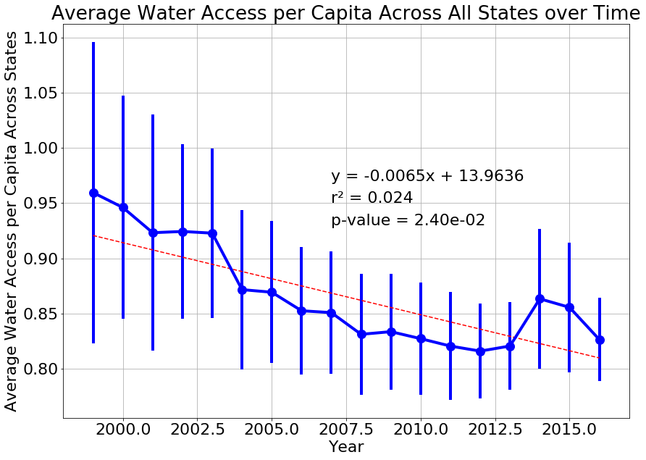
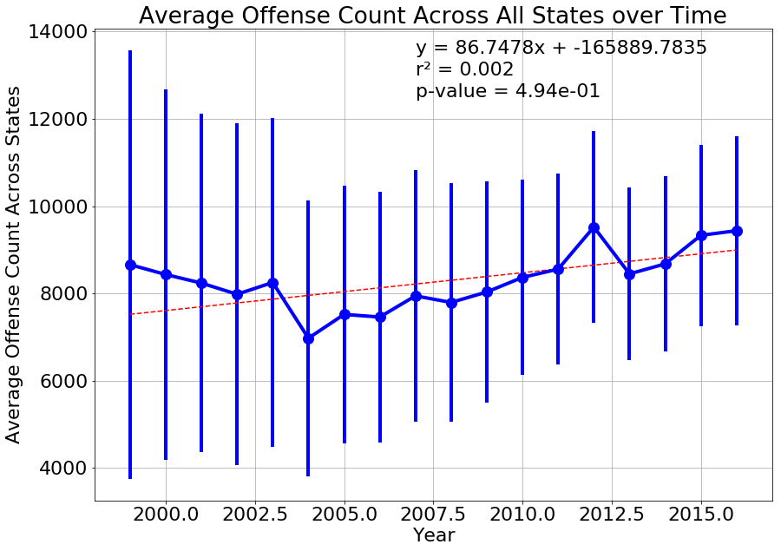
Do these areas with lower water access in US have higher instances of conflict?
Notes:
MvS Notes:
First Graph
Depicts total violent offense (violent crimes that have been indicted) data per state from the FBI API
Slight trends upwards in conflict
Second Graph
Depicts total water access data from the USGS data sets per state over the years
Water access is trending lower on average across all states over time

Slide 16
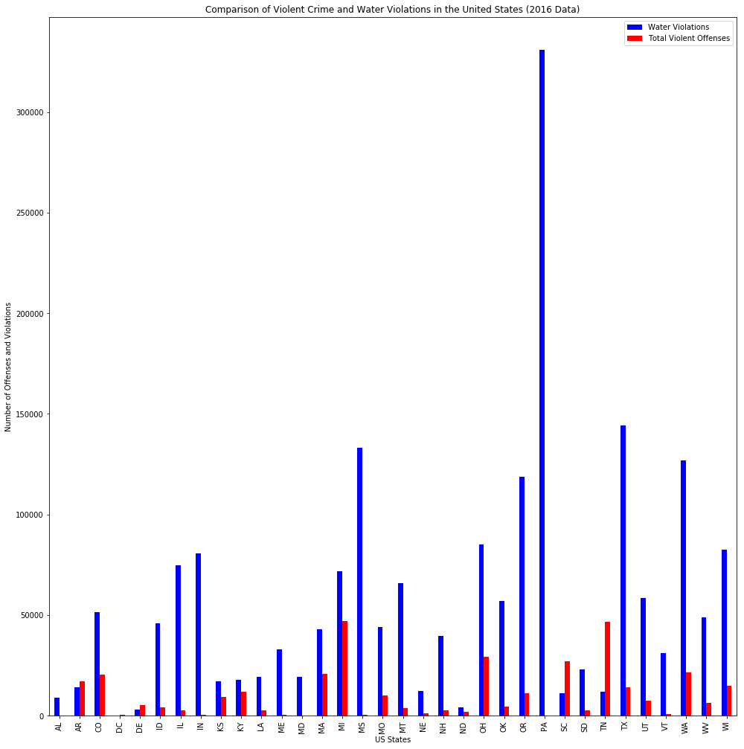
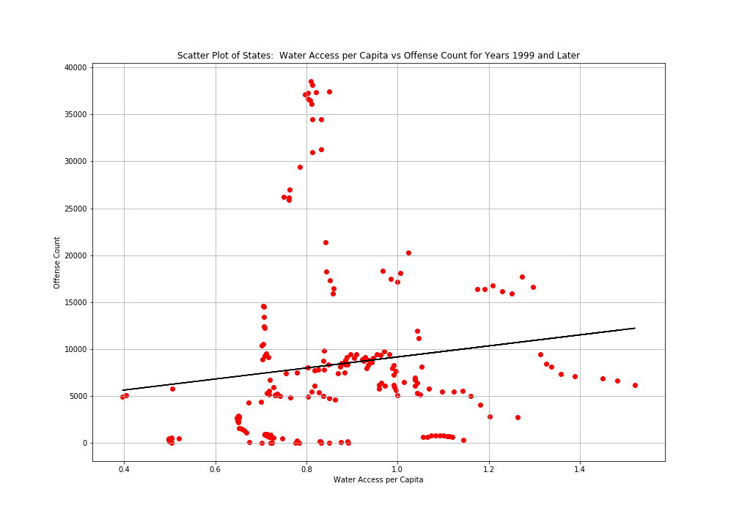
Notes:
MvS Notes:
Scatter Plot
Depicts total violent offense (violent crimes that have been indicted) data for the United States as a whole from the FBI API cross referenced with the total water access data from the USGS data sets for the US as a whole
Higher offenses in areas with lower access to water, however highest offense counts are in the lower-median access levels
Bar Chart
Depicts water violations in comparison to total violent offenses per state
More often than not, states with more water violations had lower violent offense counts
In our original question breakdowns, we wanted to identify which state had less access to water, and we determined that it was Maine (ME). If you look at the Bar Chart, Maine has one of the lower counts of water violations and one of the lowest total violent offense counts

Slide 17
Implications of our Research Method
Climate data identified several countries for further research, but some those countries did not have violent crime data
Databases lacking data governance structures
We originally wanted to work on Canadian water access, but the Canadian Government API didn’t give us the information we needed
Some states and nations had a lot of data, others had less
No universal baselines in data
IE: USGS population sizes were different than FBI agency population sizes, which were both different than US Census data
Multiple definitions around conflict, water quality, etc.

Slide 18




So…are we WANGRY?!

Slide 19
Conclusions
As climate changes continue, precipitation volume changes over time – some countries more and others less. This impacts natural freshwater reserves
Nations with less freshwater access show a slight trend toward more conflict
Almost all of the United States have adequate water available to their populations
No direct correlation between water access and total conflict at the State level or the national level

Slide 20
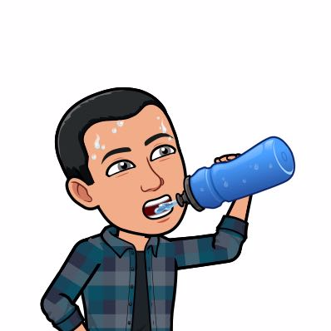
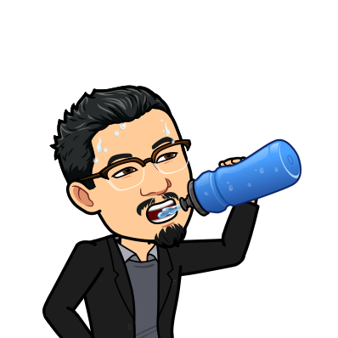
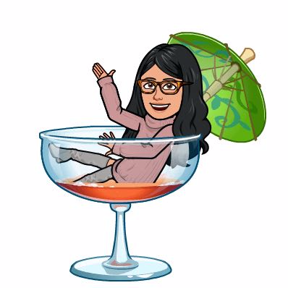

….Although the data isn’t strong… We should definitely stay hydrated!

Slide 21
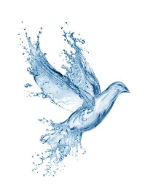
Resources
World Bank Climate Change API
USGS Water Services API
FBI API
UPCD - UPPSALA Conflict Data Program API
United Nations Data
Renewable Freshwater Resources
Net Freshwater Supplied by Water Industry
Water Quality Data
Armed Conflict Locations and Events Data
Global Health Organization Data Repositories

Slide 22
